Slide 1
﻿Capstone project – final presentation
le hoang viet anh

Slide 2
﻿Introduction and Business Problem
﻿A customer, Jerónimo, wants to open a new burger joint in Bogotá, Colombia.
Due to Bogotá’s high diversity and very large size, he asked me for help in order to find the best spot to place the burger joint.
Bogotá has 20 different Localities (Districts) and we aim to find the best one.
We need to choose a Locality that has good amount of
customers and low amount of competition.

Slide 3
Data
﻿To help Jeronimo in his search we will need to access following data:
The Localities of Bogotá, Colombia from Wikipedia: https://es.wikipedia.org/wiki/Anexo:Localidades_de_Bogot%C3%A1
The coordinates (latitude, longitude) ot these Localities of Bogotá from Open Street Map APIs
From Foursquare we will need following venues data:
the burger joint venues of the Localities
the offices venues of the Localities
the high schools venues of the Localities
the universities venues of the Localities
We will then leverage the data in order to determine which locality isthe most appropriate in order to locate the burger joint

Slide 4
﻿Methodology
﻿For each locality, all office, school, university and burger joints venues datahave been collected from Foursquare.
Then for each locality, the sums of the office, school, university and burger joints were computed.
For each of this 4 categories, a weight (or penalty) has been defined according to what Jeronimo considers the most important.
• Burger Joints have been weighted with -1, since Paolo wants to avoid concurrence.
• Schools have been weighted with 1, since student are good customers.
• Universities have been weighted with 1.5, since students are good customers.
Offices have been weighted with 2, since employees are even better customers.
• Note that the weights can be modified according to the importance of each category.
• Lastly, a score was computed for each locality as the weighted sum of the number of venues in each of the 4 categories (school, university, office,burger joints)

Slide 5
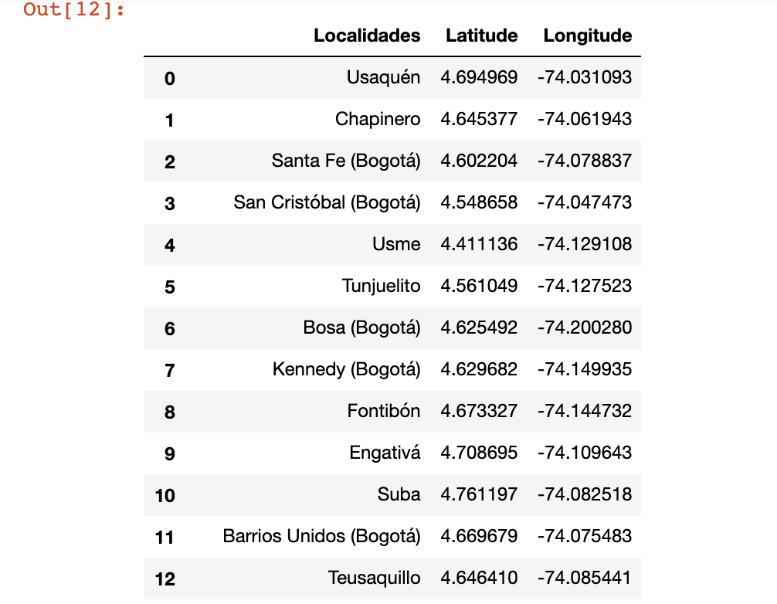
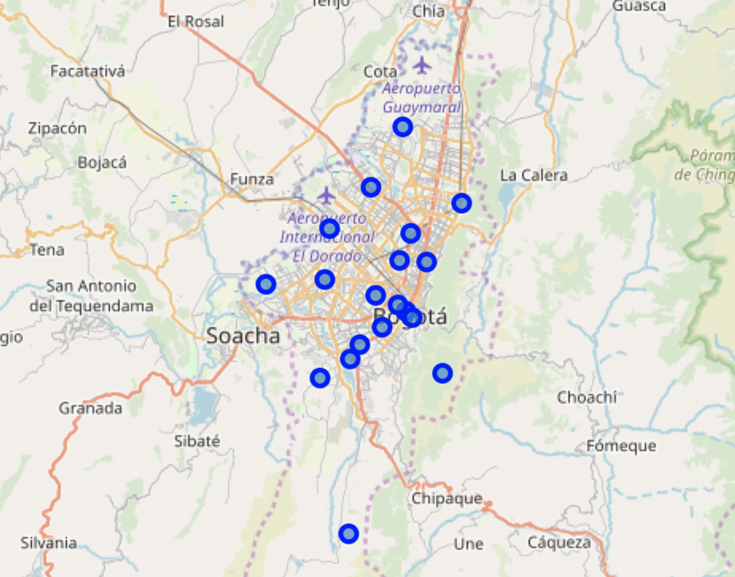
﻿Localities of Bogotá, Colombia

Slide 6
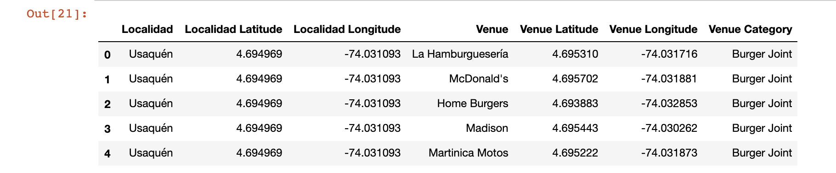
﻿Localities of Bogotá, Colombia

Slide 7
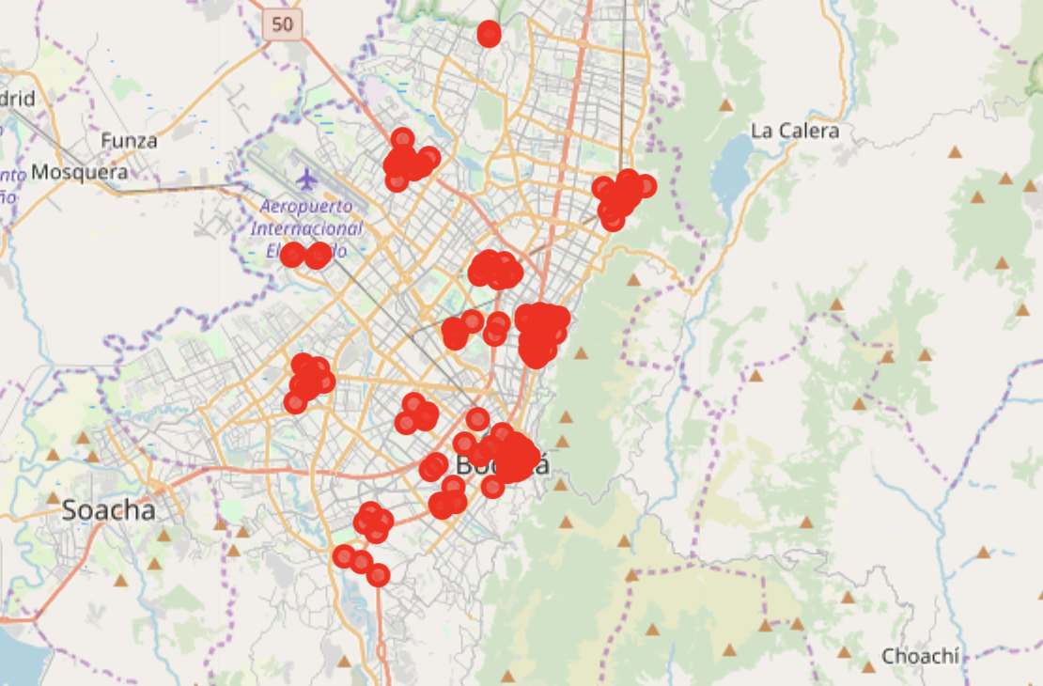
﻿Burger innBogotá, Colombia

Slide 8
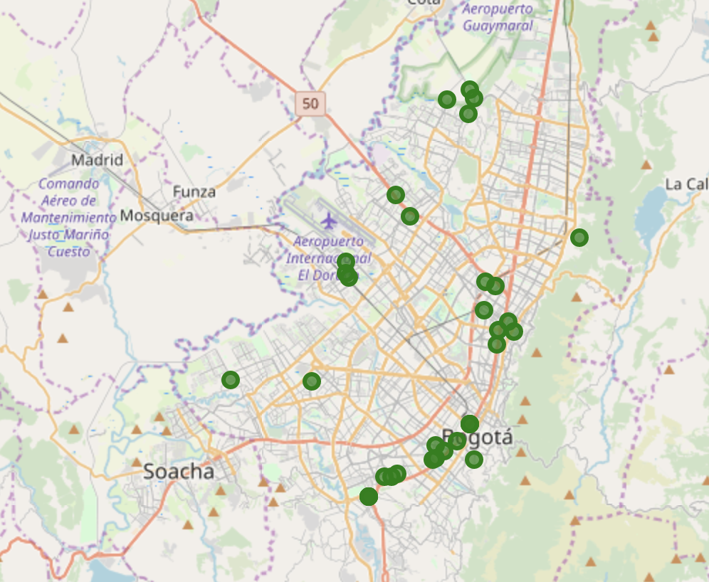
﻿High Schools in Bogotá Localities

Slide 9
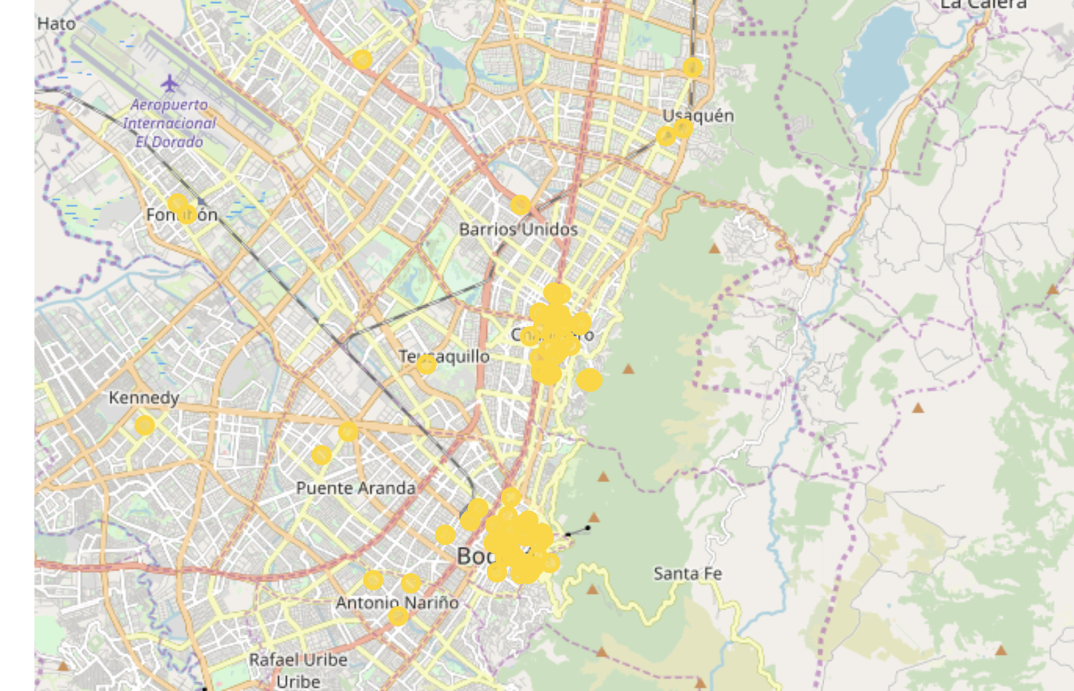
﻿Universities IN Bogotá Localities

Slide 10
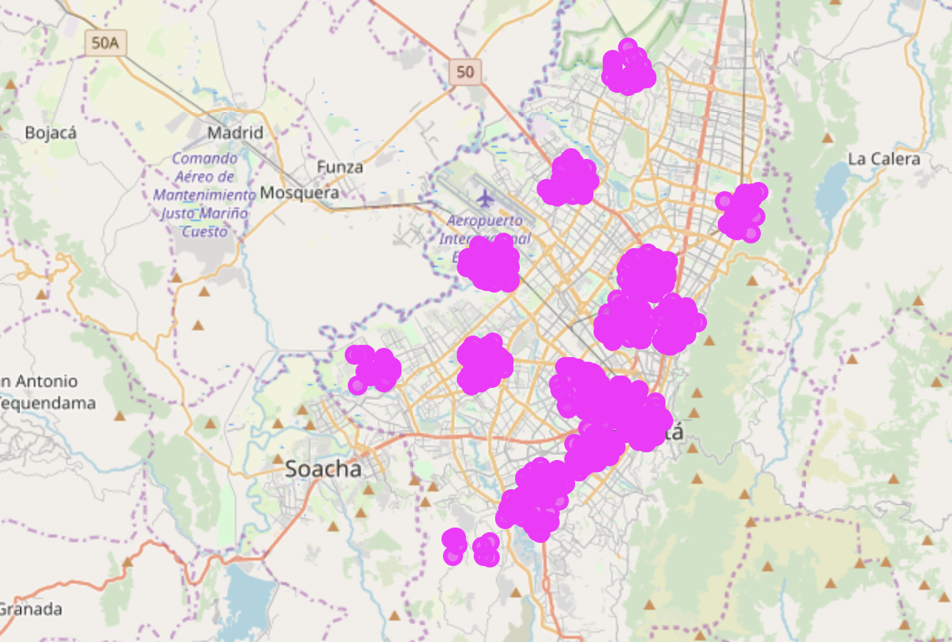
﻿Offices in Bogotá Localities

Slide 11
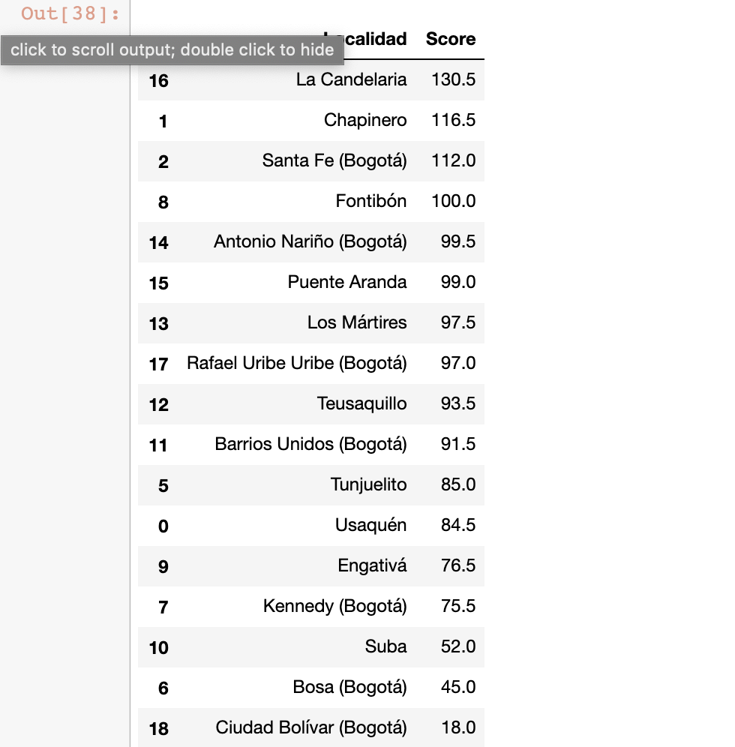
Results
﻿• The Locality with the bestscore is “La Candelaria” with 130.5, being the best option.
• Follows closely “Chapinero” with 116.
• These options maximizes the number of potential customers from offices and universities and at the same time have not too large competence.

Slide 12
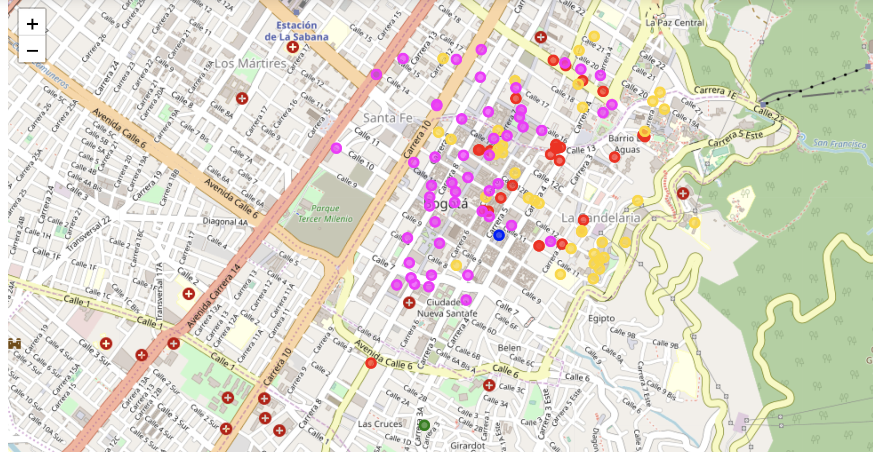
﻿Best Place for the Burger

Slide 13
﻿The following analysis can be improved with following extensions:
• Consider more categories. For example like "Night life” which is also a good source for customers. But also like "Restaurants", which even if not burger joints may by some concurrence if too many.
• In the Locality itself, it can also be computed the distance between all the venues in order to find a place with the
most number of potential customers.
• Using smaller geographical areas like Neighborhoodscould improve the accuracy for the scores.

